Slide 1
Healthy People, Healthy Places
Winter, 2013
Review
Steve Johnson, Ph.D
Portland State University
Portland, Oregon

Slide 2
Final Exam
While the test is based mostly on the textbooks, lecturer, video tapes, and class discussions should also be included in your answers when appropriate. You should study all questions. While there will not be surprise new questions, some questions will not be on the final exam
Please bring new Bluebook/Greenbook to class. It is not open book.

Slide 3
Class Framework
Built (Urban) Environment
Land Use
Patterns
Urban Design
Transportation
Food
Nature
Activities Patterns
Public Health

Slide 4
Modifiable Behaviors Associated with Deaths, US, 1990
Three hundred thousand!
Notes:
This is an attention-grabber. While tobacco is still the number one killer, as far as modifiable behaviors go, inactivity and poor diet are a close second.
If you have time, you can point out a few more things:
Inactivity and poor diet add up to more than all the other causes listed below;
Illicit drugs, where the US has spent inordinate amounts of resources over the past 30 years, are low on the scale;
Motor vehicle deaths, though deplorable and unacceptable, are also relatively low. You can use this point if there is a feeling expressed that walking and biking are potentially dangerous activities – the risk associated with not doing anything are much greater.

Slide 5
Health greatly affected by
Life chances (Social status etc.)
Exposure to Risk
Influence of sub cultures
Social Support Networks

Slide 6
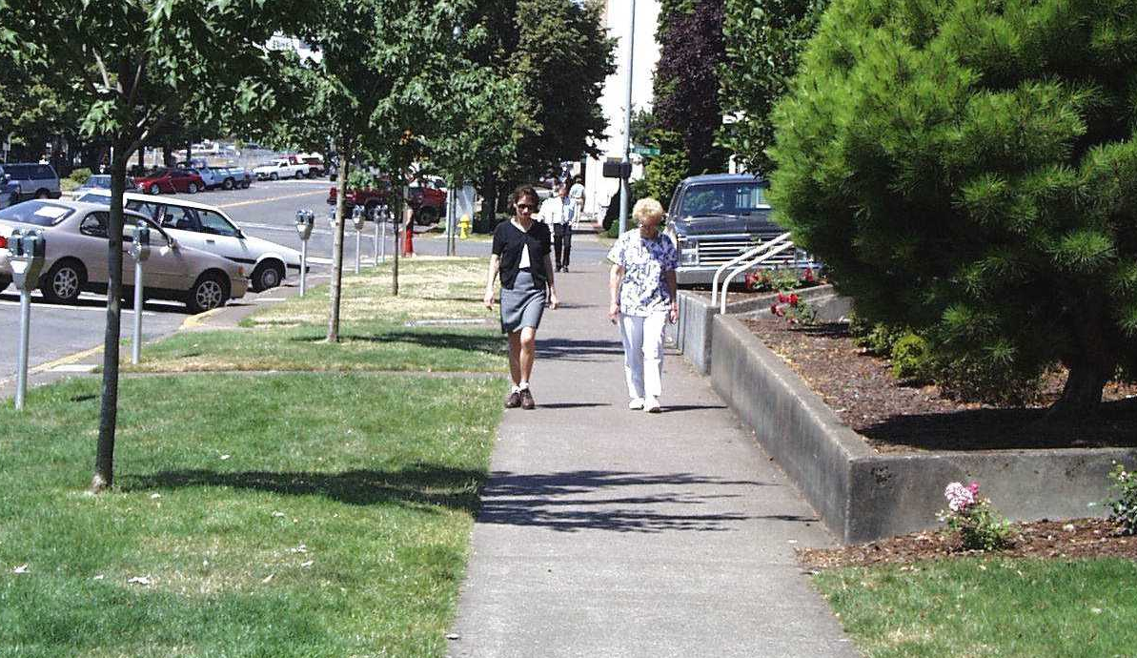
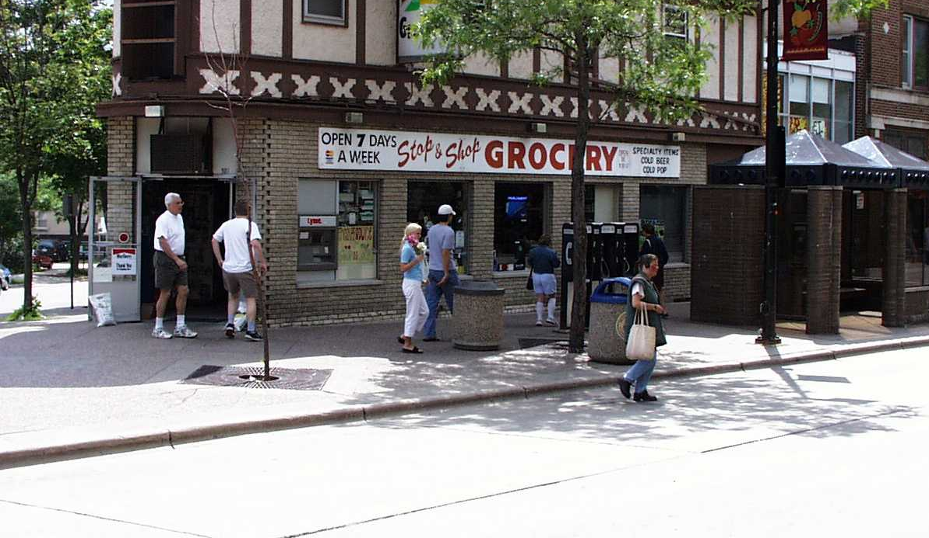
How do we create Active Community Environments?
Street designs that improve pedestrian & bicycle convenience, comfort & safety
Development patterns that improve the walking & biking environment
Notes:
Now we get to the land-use and transportation link. We need to create community conditions so that walking and biking can occur routinely. So both street designs and development patterns matter.

Slide 7
Urban Form--19th Century
Crowded
Dirty
Polluted
Smelly
Noisy
Dangerous

Slide 8
Health of Cities
19th Century: Miasma, mixed uses
But also exercise was a part of life
The Automobile changed everything
Focus of Frank book is how can cities be designed to incorporate exercise that is recreational and has purpose

Slide 9
Urban Form Today
Decentralized
Dispersed
Separated land uses
Auto-centric transportation networks

Slide 10
Automobile Society
Autos account (in USA) for 86% of all person trips; walking only 5%
Nonmotorists tend to be younger, less educated, poorer and live in urbanized areas
But not so much in other countries
Reasons: gas price, urban form, safety, public incentives
Chart illustrating differences

Slide 11
Place Matters
We are urbanizing. In 25 years 2/3 of us will live in cities (worldwide)
Many of us live in placeless world
Place is physical, cultural, social and mental
All places have some risk and hazards
  Physical, social, and psychological
Place does matter, more for some than others

Slide 12
Ecologies of Disadvantage
Being in the wrong place may be a function of social structure
While placeless, some of us live in Medieval-like gated or walled communities
Environmental Justice

Slide 13
Characteristics of urban Social Life
More separation between private and public life
More separation also in private homes
Growth of individualism at expense of intergroup tolerance and public civility
Americans spend less than 1 hour outdoor everyday

Slide 14
Frank: Chapter three
Some of the most prevalent forms of disease today can be prevented or at least lessened through moderate physical activity
Surgeon general 1996--moderate activities like walking and biking can have significant health outcomes
But only 1 in 3 adults (USA) engages in regular, sustained exercise to meet the public health recommendations
Structured physical regimes may have better effect on health, but are also more difficult for people to maintain
Small interventions can help--stairs instead of elevators, safe biking to school, etc.
People more likely to continue long term with moderate interventions, esp. ones that also have practical outcomes

Slide 15
Frank, chapter Four: Physical Activity
Older parts of cities often better but safety may be factor
Utilitarian exercise may be best
Auto domination: 84% of all trips; in Italy its only 25%
Non-motorists tend to be younger, less educated and poorer and more likely to be employed or live in urbanized areas
Surveys show there is a gap between how people travel in USA (car) and what they would like to do

Slide 16
The costs of privatization
(Fortress America article)
Society has promoted growth of individualism at expense of inter-group tolerance and public civility.
what can happen is that segregated communities are created that have limited capacity to bridge to other communities and political power, while being able to take care of each other.

Slide 17
Special Needs: Elderly
walking important exercise for elderly and can be important social one as well
Elder use cars because of safety concerns and in suburban areas not practical for utilitarian trips
in some other countries the elder do make more use of walking (chart)

Slide 18
Special Needs: Children
nearly 40% of all high school seniors do not meet health guidelines for physical activity, down from 9th graders (72%)
children today don't walk to school, 10% down from almost half 30 years ago
While playgrounds are important, children do like to play in the neighborhood, and on streets
in typical suburban areas the street may be better to play in (cul-de-sacs) but the linkages to other play areas and schools and other destinations not

Slide 19
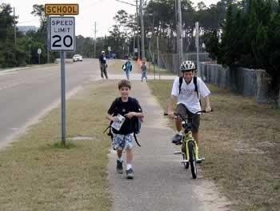
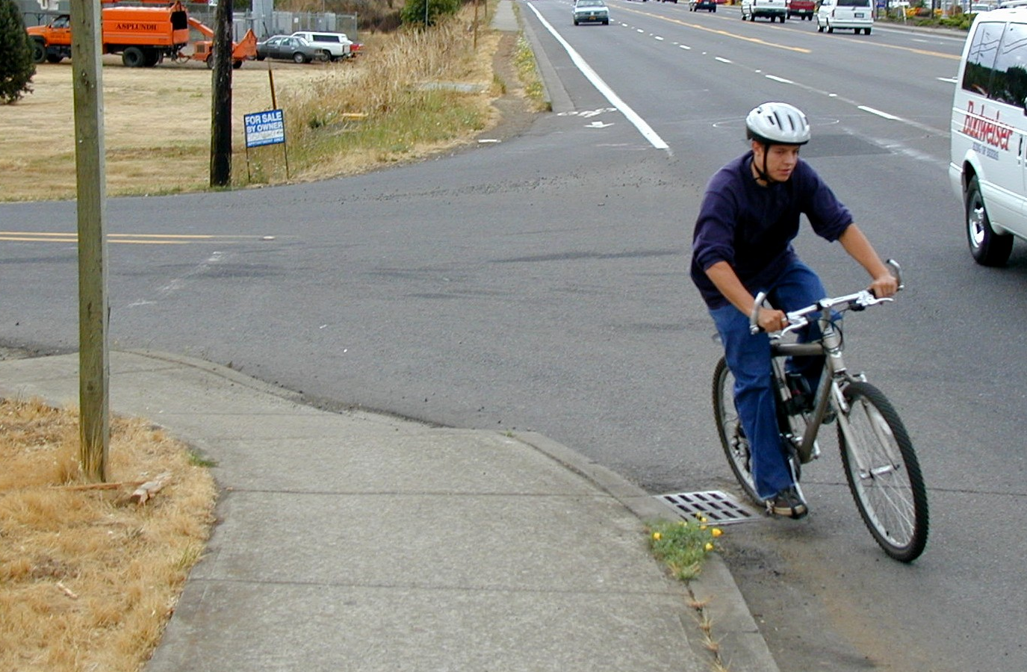
What about children going to school?
Only 31% of trips under 1 mile are by walking
Only 2% of trips under 2 miles are by bicycling
Notes:
Self explanatory – American kids don’t walk or bike like they used to.
Time permitting – ask the audience to raise their hands if they walked or biked to school as kids. Most hands will go up. Then ask those who are parents to raise their hands if their own kids walk or bike to school. Watch the hands stay down.

Slide 20
What Hinders Kids from Walking or Biking to School?
Distance
Traffic
Weather
Crime
School Policy
Other
No Barriers

Slide 21
Special Needs: Poor
Have less leisure time
Less discretionary income
Fewer parks and recreation
Rely more on walking/bus but can’t reach all services
Safety concerns in some areas

Slide 22
Transportation: Main points
Three types of urban transportation systems: organic, grid, hierarchical
City building and rebuilding, until recently “new” communities not retrofit
Biking: recreational or serious commuting, integrated or separate
Transit systems: need for density and mixed use to be effective

Slide 23
Automobile Society
Autos account (in USA) for 86% of all person trips; walking only 5%
Nonmotorists tend to be younger, less educated, poorer and live in urbanized areas
But not so much in other countries
Reasons: gas price, urban form, safety, public incentives
Chart illustrating differences

Slide 24
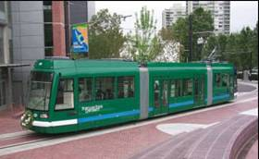
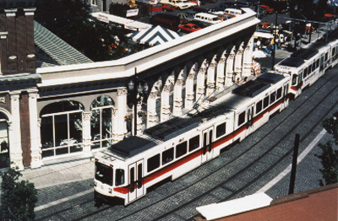
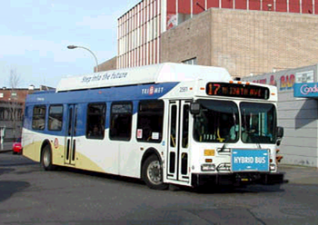
Transportation
Transit ridership has increased 75% since 1990.
Tri-Met
Notes:
Two big areas of focus:
1. Land use and the shape and density of development
- keep City compact
- mix job with housing
- encourage development near transit arterials
2. Transit
- expanded light-rail system
Also promoting other alternatives to private vehicle travel. . .

Slide 25
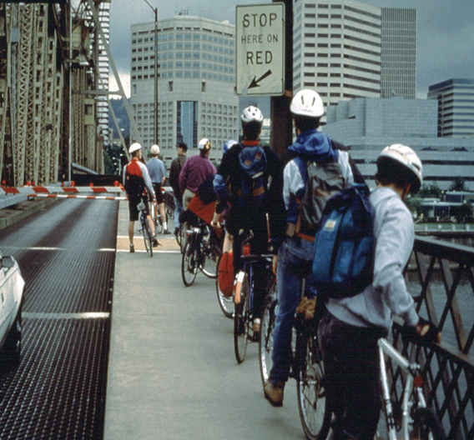
Bicycle commuters increase
500%
10,000 bikers every day to downtown

Slide 26
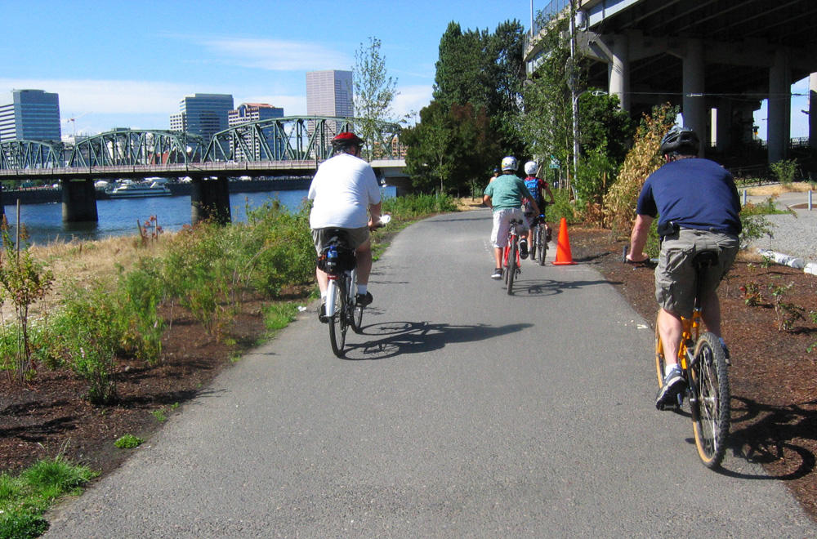
Bicycle facilities
Separate trails
Bike lanes on major roads
Shared lanes on other roads
Bicycle boulevards
  Neighborhood streets that discourage through motor vehicle traffic and give priority to bicycles

Slide 27
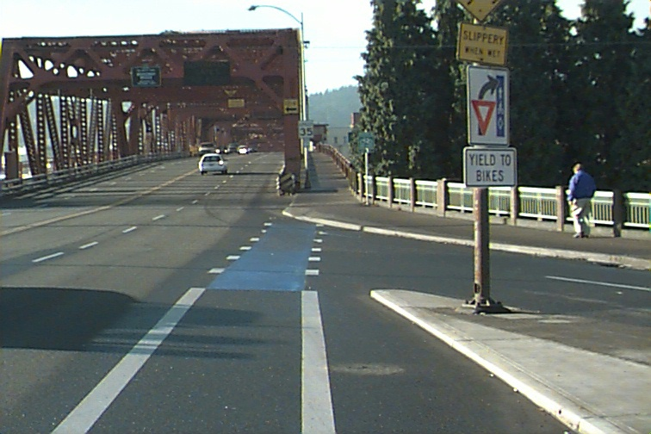
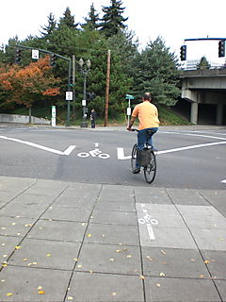
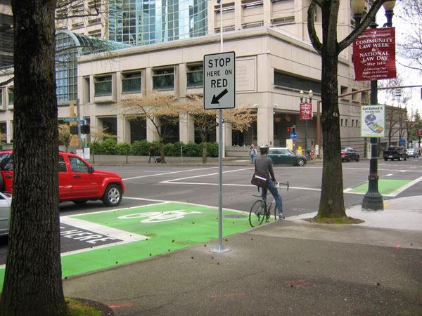
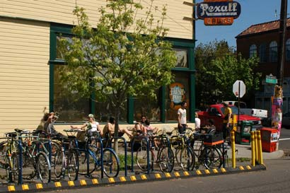
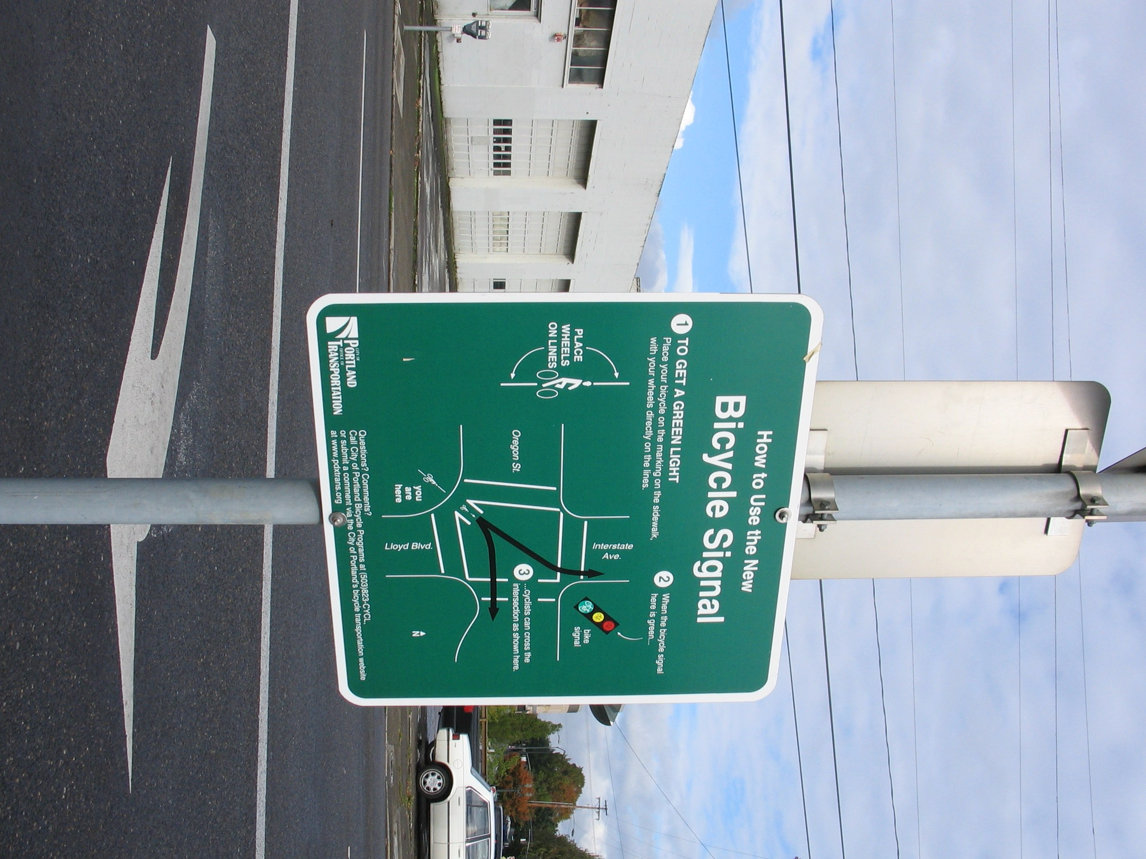
Bicycle facilities
Pavement markings to
improve safety
Special traffic signals
Parking

Slide 28
Mode Split Comparison:
Europe and North America
100
Auto
Transit
Walk
Bicycle
80
60
40
20
0
Netherlands
Germany (western)
Sweden
Germany (eastern)
France
Canada
data 1990
or later
Denmark
Switzerland
Austria
England & Wales
Italy
U.S.A.

Slide 29
Mike Houck--Greenspaces

Slide 30
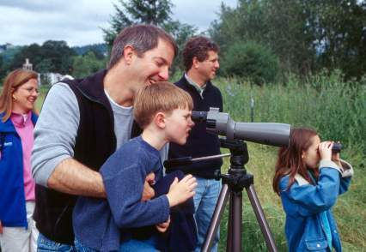
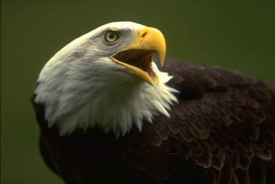
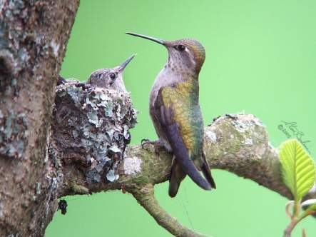
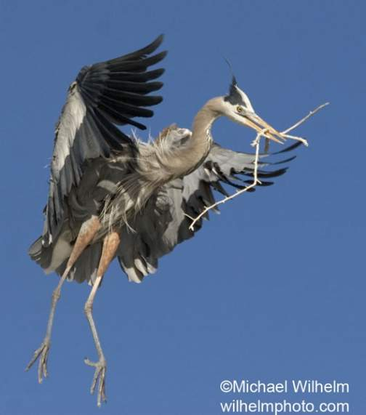
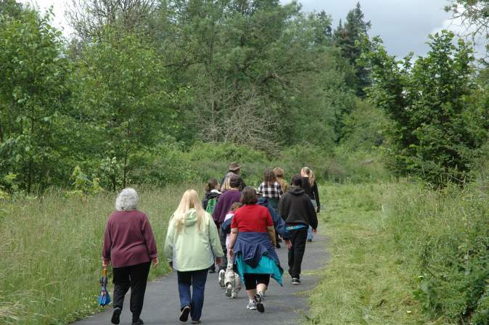
Nature

Slide 31
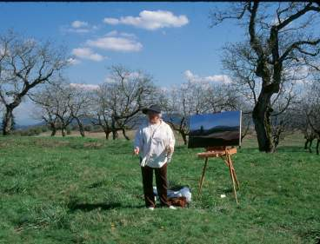
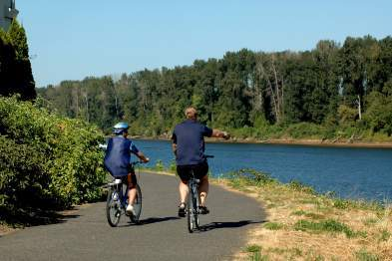
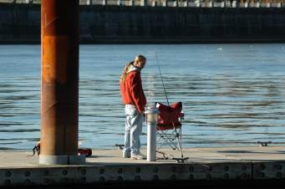
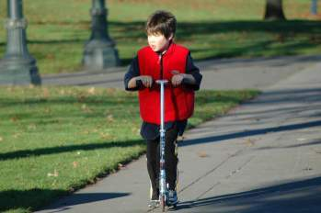
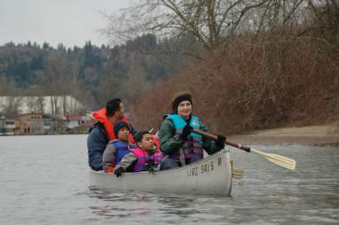
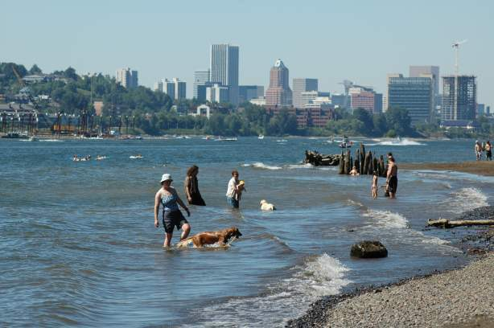
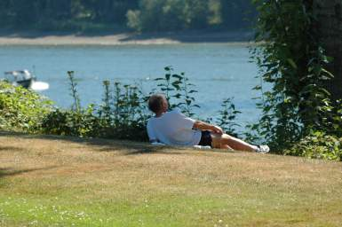
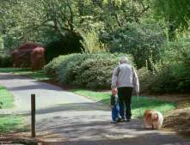
Areas for recreation and leisure

Slide 32
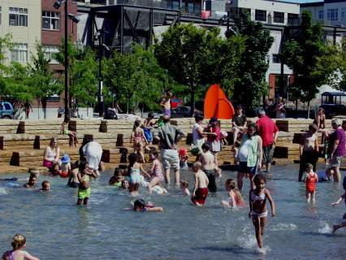
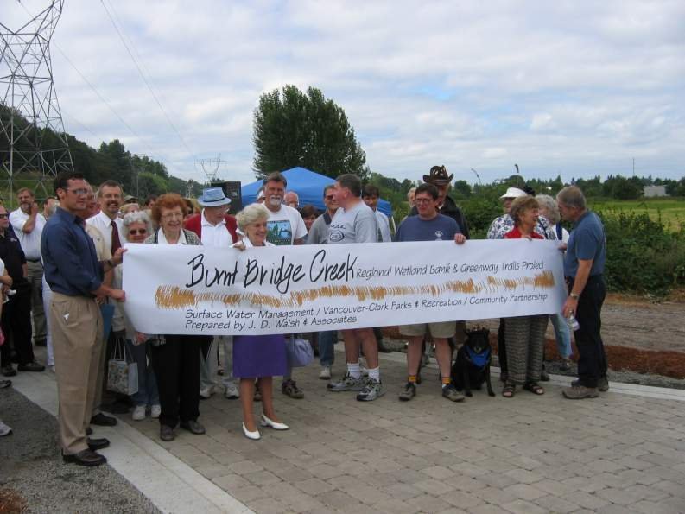
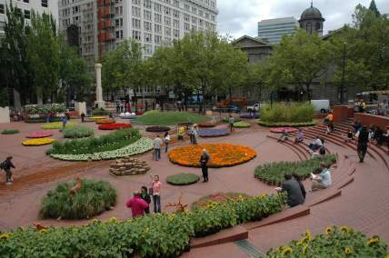
Public spaces that bring people together
and connect them to their community

Slide 33
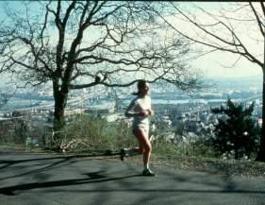
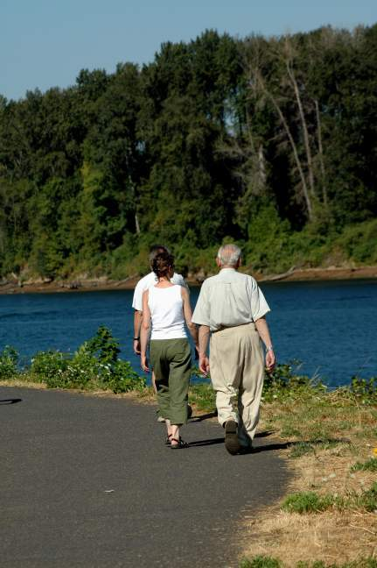
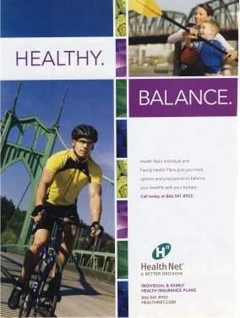
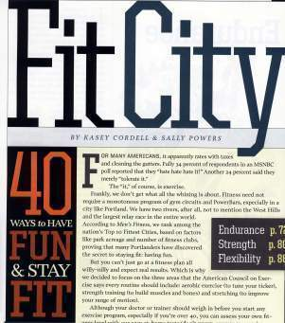
The System Promotes Human Health, Fitness, and Well-being

Slide 34
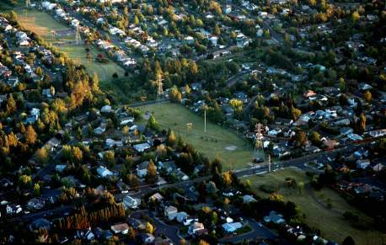
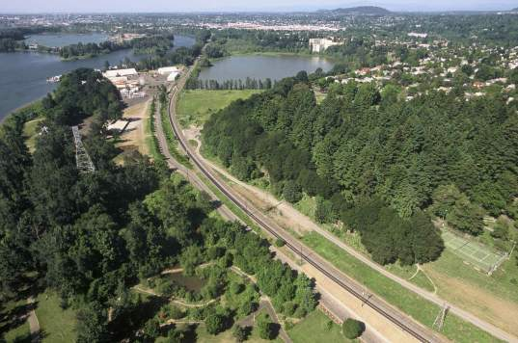
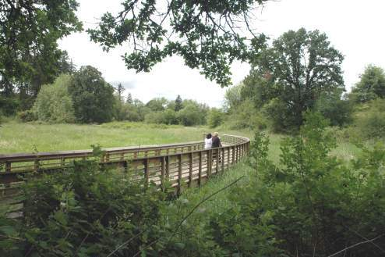
Trails and greenways are a fundamental
infrastructure actively used to augment transportation
networks and link parks, natural areas, waterways,
public facilities, neighborhoods, and regional centers.
Springwater on the Willamette
Powerline Trail Beaverton
Rock Creek Trail Hillsboro

Slide 35
A Challenge: Bringing Nature
Back into the City
Government Policy pushed nature outside the city
Citizens brought it back into the city

Slide 36
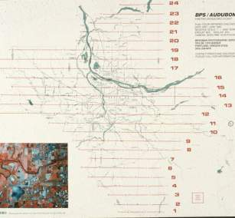
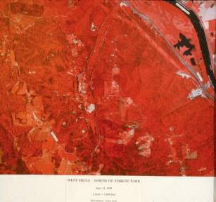
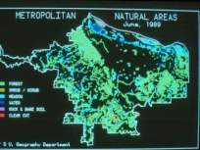
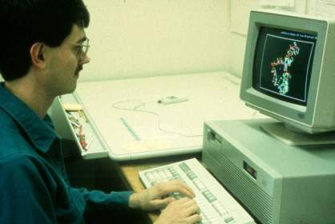
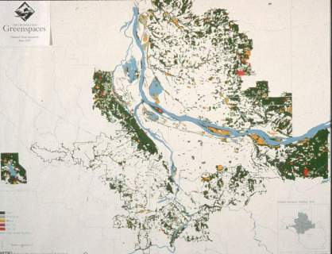
PSU’s Dr. Joe Porascky and
graduate student Paul Newman
create first regional natural
areas map for Metro regional
park study and inventory,
June, 1989
Notes:
Color IR Flight Lines.jpg. Map showing flight lines that Bergman Photographic Services of SE Portland flew for the four county, bi-state color infrared photography flight. Audubon Society is listed with BPS because Portland Audubon Society offered to put up $20,000 to guarantee BSP that they would be paid for the flight, should Metro fail to raise the funds. Metro had no money in its budget to pay for the flight and the participants were concerned that waiting a full year, when Metro might have the funds, would result in a loss of momentum for the greenspaces initiative. Joe Poracsky successfully and correctly argued that the flight would ultimately be viewed as a boon to BPS and Mel Huie went to work to raise the $20,000, which he successfully did. Funding came in small amounts (e.g. $100 from Friends of Fairview and Blue Lakes) and larger amounts from local jurisdictions, the Corps of Engineers, and others. Ultimately the entire $20,000 was raised. Subsequent to this effort Bergman Photographic began yearly flights on speculation because the response was so positive, interestingly, from the development industry. (Joe Poracsky can fill in details on this point)

Slide 37
Greenspaces movement begins

Slide 38
Result: density and Protecting our Farmland
The average new lot in 1998 was 6,200 square feet (576 sq meters), down from 12,800 square feet (1189 sq meters) in 1978
By 2040 Portland’s density will exceed New York City

Slide 39
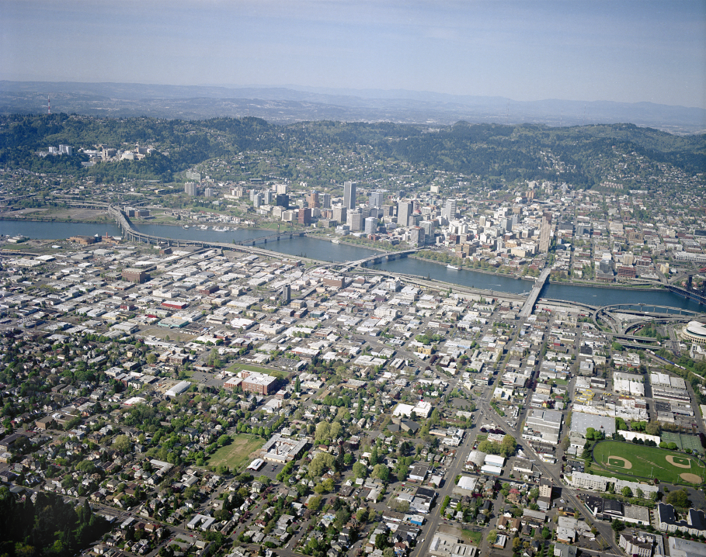
City of Portland - 2005
25 sq. miles rooftops
45 sq. miles pavement
City 140 sq. miles

Slide 40
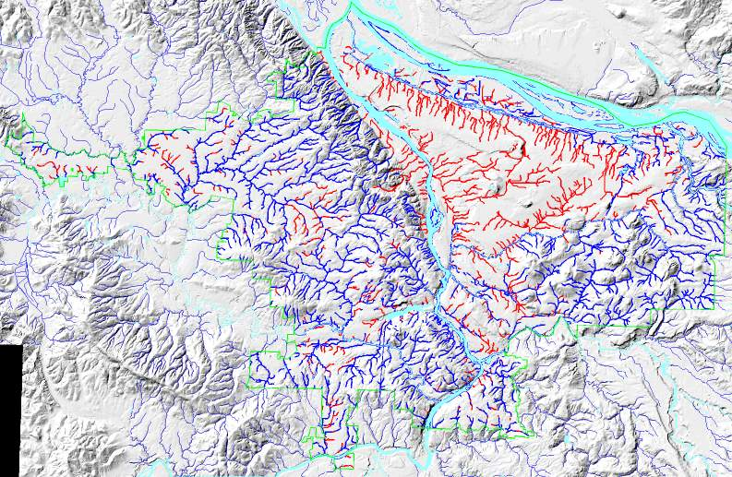
Disappearing streams

Slide 41
When rain water falls on buildings, parking lots and streets, what happens?
Absorbs contaminants
  Suspended solids, bacteria, hydrocarbons, pesticides, chlorides, trace metals, etc.
Heats up
Flows off quickly--
  Volume + Velocity = Flooding + Erosion
No longer generates life
People cut off from water
  No celebration of its central role

Slide 42
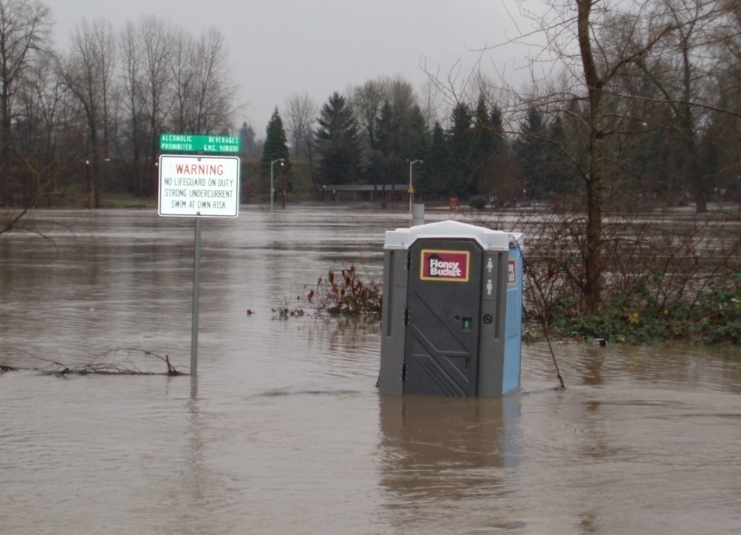
How building affects streams: Quantity
Photo: Clackamas County WES
Photo: Johnson Creek
Watershed Council

Slide 43
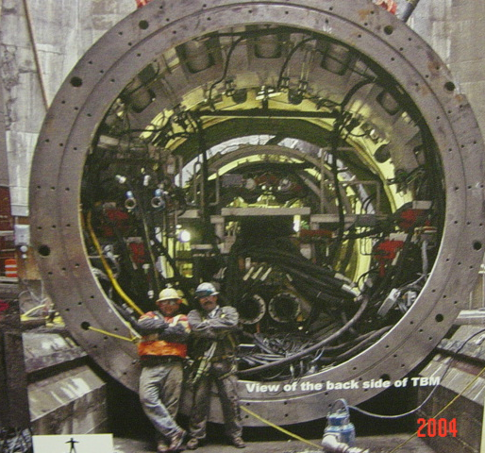
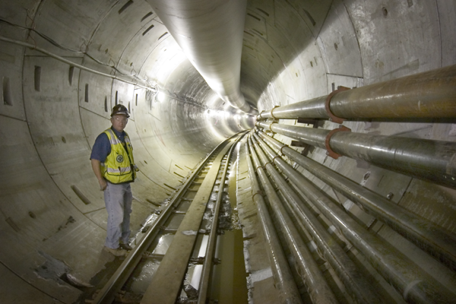
CSO tunnels are expensive to build ~ Portland’s $1.4 Billion, expensive to maintain? and how long will they last?
Grey to/and Green
Notes:
On-going O&M will cost $.008 gal/yr. and the pipe capacity is at 2011 land use, not designed for more flow, we have to keep future development off the system.

Slide 44
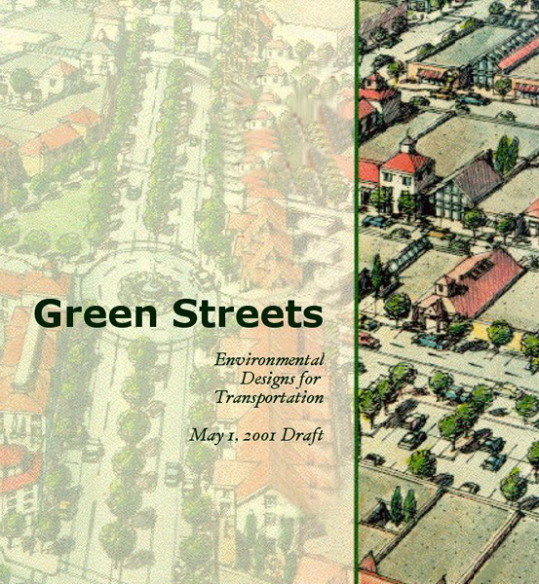
Green Streets Handbook

Watershed strategies
On-site versus off-site solutions
Retrofits versus new development
The role of street trees




Slide 45
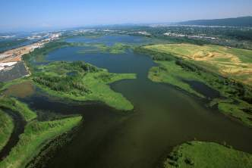
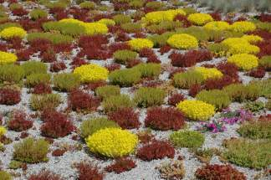



The system is an essential part of the
urban infrastructure and intentionally used to
improve the region’s air and water quality.

Slide 46


The future:
rainwater integrated
into buildings

Slide 47

Portland State University Storm Water System

Slide 48

Multnomah Co. Building with Ecoroof 2003

Slide 49

Portland Building Ecoroof

Slide 50


Slide 51


Slide 52


Urban Foodscape
Now we are attempting to also integrate urban farming

Slide 53
Urban Food Systems
Now we are attempting to integrate food systems into cityscape

Slide 54
Framing Food Security
ANTI-HUNGER FOOD SECURITY
Treatment Model Prevention
Individual/Household Unit Community
Shorter Term Time frame Longer Term
Emergency Food Focus Food System
Commodities/Cheap Food Agriculture Impact Fair wage/Local

Slide 55
Access to Food Strategies
Research, e.g. equity atlas
Public Incentives for attracting new grocery stores
Zoning
public investment
Farmer's Markets
Community Gardens
Other Public Spaces that can be used as gardens
Remember the underlying power of
Farm to school programs
Consumer power--buy more organic and local
Farmer to Restaurant Collaborative
Farm and Food Education Centers and Programs
School Gardens
Community supported farms

Slide 56

Diggable Cities Inventory

Slide 57

Farm to School Program
Students at Abernathy School examining their own produce for school lunches

Slide 58

Growing Gardens
Growing Gardens has Helped 350 families
Develop gardens
In their back yards
and help create 35
Larger gardens at
schools

Slide 59

Creating Connections in the Food System

Slide 60

Reed College Community Garden

Slide 61

Community Supported Farms
In Portland there are
35 community supported
Farms serving on
Average 30-35 family
members
47th Street Farm at Zenger Farm Education Center
Notes:
Today in the Portland area there are at least 25 such operations, serving between 15—30 families each. Other hybrids of the CSA model have emerged in recent years. Organic Direct, Organics to You, and Urban Organics all deliver organic produce to residences or places of employment.

Slide 62

Farmer’s Market
Notes:
Between 1998 and 2005 the number of farmer’s markets in Oregon nearly doubled from 38 to 68

Slide 63
Social Sustainability—Social equity
Social Equity
Social Capital
Community Participation

Slide 64

The Coalition for a Liveable Future is a partnership of 90 organizations and hundreds of individuals working for a healthy and sustainable Portland-Vancouver metropolitan region.

Slide 65
WHAT DO WE MEAN BY EQUITY?
An Equitable Region is one where…
Every person has access to opportunities for meeting their basic needs and advancing their health and well being.
The benefits and burdens of growth and change are fairly shared among our communities.
All residents and communities are involved fully as equal partners in public decision-making.
www.equityatlas.org
Notes:
65
In the Equity Atlas, “equity” was defined as a region where:
Every person has access to opportunities for meeting their basic needs and advancing their health and well being.
Second, the benefits and burdens of growth and change are fairly shared among our communities.
And third, it’s a place where all residents and communities are involved fully as equal partners in public decision-making.

Slide 66

SOME OUTLYING AREAS WITH GROWING POVERTY HAVE POOR TRANSIT ACCESS
TRANSIT ACCESS SCORE, AVERAGE BY NEIGHBORHOOD/CITY
Notes:
66
However, the recent population and development patterns we discussed earlier create new challenges that will need to be addressed: there are areas of growing poverty, mostly in outlying communities, with poor access to transit.
For example, in Happy Valley – Rock Creek the percent of population within ¼ mile of stop is only 43% (below 58%) and has a lower network score than the region (5.07 compared to 5.95 regionally). In both measures Happy Valley – Rock Creek is in tier 2.
This map shows transit access scores for neighborhoods throughout the region. The Atlas creates a transit access score for each location in the region based on the walking distance to the nearest public transit stop, the population sharing that stop, and the frequency of rides at that stop. This map shows these transit access scores averaged by neighborhood.
The pale yellow areas outlined in red in the map depict the areas in our region with high or rapidly growing poverty rates and/or high levels of diversity that have poor transit access.
For example, Park Place and Barclay Hills (CLICK) were among the communities with the highest poverty rates and populations of color (10.9% and 16.11.8% respectively) in 2000. It also is among the 20 neighborhoods with the most rapidly increasing poverty rates. The average walking distance to the nearest transit stop is 7 city blocks for each area, well above the regional average.

Slide 67

POOR PEOPLE AND PEOPLE OF COLOR
HAVE WORSE ACCESS TO PUBLIC GREENSPACE AND NATURE
PERCENTAGE OF POPULATION WITHIN ¼ MILE OF A PUBLIC GREENSPACE, BY NEIGHBORHOOD/CITY ZONE
Notes:
67
This map shows the percent of the population within ¼ mile of a public greenspace in the Portland-Vancouver region by neighborhood or city zone.
Neighborhoods with the worst access include areas of North Clackamas, and various neighborhoods in N and NE Portland (CLICK). In the Overland/Southgate area [CLICK] there is only one small pocket park (Mill Park). However, there are efforts to address this disparity – such as Metro’s Nature in the Neighborhood. Northwest Housing has started preliminary conversations to try and get some capital funds for parks in conjunction with affordable housing. The area has existing resources with Johnson Creek and the Springwater Corridor.
Neighborhoods with the best access include Homestead (SW Portland) (CLICK), Falls View (Oregon City) (CLICK), and Skyline Ridge and Forest Park-Linton in NW Portland (CLICK).

Slide 68

AREAS OF INCREASING POVERTY HAVE POOR WALKING ACCESS
PERCENTAGE SIDEWALK COVERAGE AROUND ELEMENTARY AND MIDDLE SCHOOLS
Notes:
68
The Atlas measures walkability by looking at the percentage of sidewalk coverage around schools. We wanted to focus on children because of the growing public health crisis of childhood obesity. There is a growing recognition that walking to school may be an important way for children to maintain physical activity.
The dots represent the areas within a one-mile radius of each school in the region. The areas with blue dots have the best sidewalk coverage.
Looking at the map, we can see that older neighborhoods in the region – primarily those in Portland’s urban core -- tend to be more pedestrian oriented, and as you move further out, the sidewalk network becomes poorer.
Comparing the demographic patterns that we discussed earlier with this map, we see that as low-income families and families of color move outward from inner Portland neighborhoods, many of them are finding themselves in schools where walking is more difficult. Examples include high poverty schools in the Beaverton, Hillsboro, David Douglas, Parkrose, and Reynolds Districts [ CLICK]. The circled schools are elementary schools where 50% or more of their students receive free and reduced lunch.

Slide 69

WALKING ACCESS TO GROCERY STORES
ACCESS TO GROCERY STORES
PORTLAND-VANCOUVER METRO AREA
Notes:
69
This map shows walking access to grocery stores. The darkest blue areas in the middle are the best served areas.
On the whole, the map shows that low income communities and communities of color have decent walkable access to grocery stores.
The reds are mainly found in far out rural locations or outlying suburbs where a small number of central stores serve large areas. Many of the outlying suburbs tend be wealthier, so not having grocery stores within walking distance does not significantly impact residents’ access.
But, there are a few red areas with higher than average poverty and diversity that have poor walking access to grocery stores. These areas are a cause for concern.

Slide 70

Map created by Linda George, 2006

Slide 71
Characteristics of urban Social Life
More separation between private and public life
More separation also in private homes
Growth of individualism at expense of intergroup tolerance and public civility
Americans spend less than 1 hour outdoor everyday

Slide 72
Importance of Social Networks
People with good social networks have better health
Urban design effects social interactions (front porches for example)
Other elements (e.g., creating indefensible space) of neighborhood can impact other social and individual developments
Insecure environments impede some basic human development traits like: affiliation, esteem, cognitive development

Slide 73
Social Networks
Thiel studied 20th-century philosophy as an undergraduate at Stanford University. He received his B.A. in Philosophy from Stanford in 1989 and acquired a J.D. from Stanford Law School in 1992.[8]
An avowed libertarian, he founded The Stanford Review in 1987 along with Norman Book. The Stanford Review became famous for challenging campus mores including political correctness and laws against hate speech. The Stanford Review is now the university's main conservative/libertarian newspaper.
Thiel formed friendships with other students at Stanford, many of whom contributed to the Stanford Review. These include Keith Rabois, David O. Sacks, and Reid Hoffman. Some of these friends later took up jobs at PayPal (co-founded by Thiel) and became part of the PayPal Mafia.

Slide 74

Social and Civic Space

Slide 75
Social Capital
James Coleman
Goal: to re-establish sociology's worth in an age dominated by economics
To place value on social relations, social networks and community building

Slide 76
What is social capital?
If physical capital is wholly tangible, being embodied in observable material form, and human capital is less tangible, being embodied in the skills and knowledge acquired by an individual, social capital is less tangible yet, for it exists in the relations among persons.
Example, a park that is safe in a neighborhood vs. having to secure it with police

Slide 77
Bridging and Bonding Social Capital
Difference between bridging (or inclusive) and bonding (or exclusive) social capital
Bonding capital constitutes a kind of sociological super-glue, whereas bridging social capital provides a sociological WD-40

Slide 78
Collaborative Consumption
Zip cars
Tool Lending Libraries
Cooperative urban farms
Helping Hands
School Bus walking
Shared Fruit Trees
Social Seating
Social Eating
Survey Monkey
Shared personal computer networks
Co-housing

Slide 79
How do we create Active Community Environments?
Street designs that improve pedestrian & bicycle convenience, comfort & safety
Development patterns that improve the walking & biking environment
Notes:
Now we get to the land-use and transportation link. We need to create community conditions so that walking and biking can occur routinely. So both street designs and development patterns matter.

Slide 80
Conceptual and Practical Problems in Design
Divergent requirements in physical design
Difficult to research people’s transportation and housing needs and desires
Residential self selection may mean pedestrian friendly areas dominated by pedestrian-bike oriented people
We don’t have experience living in quality high density (suburban ideals)

Slide 81

Eyes on the Street?

Slide 82


Slide 83


Slide 84
Social Elements: social networks, social capital
Prevalence, strength and interlocking nature of social networks
Degree to which neighbors take personal responsibility for neigh. Problems
Extent of surveillance done by neighbors
Participation in voluntary organizations tied to neighborhood and broader community

Slide 85
Collaborative Consumption
Zip cars
Tool Lending Libraries
Cooperative urban farms
http://www.taskrabbit.com/main/howitworks

Slide 86



Third Places
Public or Civic
Space

Slide 87

Everyone should know where they are at all times and everyone should know how to live in place sustainably
My Bioreigon
A Bioregion: A distinct area where the conditions that influence life are similar and these in turn influence human occupancy. The extent of a bioregion can be determined by scientific means.
The idea of a bioregion, however, is cultural. It defines both a place and adaptive ideas about living in that place

Slide 88


Slide 89
Bioregional Quiz
Where does your water come from?
Where does your used water go?
What is the soil like in your back yard?
What direction do winter storms generally come from?
Where does your garbage go?
How long is the growing season?
Name five native trees
What is the average rainfall in Portland (in inches)
What is one the primary geological events that shaped Portland?
From where we are which way is north?
What is the primary source of electricity for Portland?
Name two editable native plants.
What is one of the first signs of spring in our region?
What did Portland look like: 50 years ago, 150 years ago, 200, and 10,000?

Slide 90


Creating Sustainable
Community Stories
A long long time ago
In a land called Ecotopia
A People begin to create
a new story about their place

Slide 91



Contrasting Community Stories
Los Vegas
Portland

Slide 92

City Repair: Intersection Repair, Free Tea stand
WE CAN DO SOMETHING ABOUT IT

Slide 93


Slide 94
Repairing the City Street by Street
City Repair Project

Slide 95
Repairing the City Street by Street
City Repair Project

Slide 96
Repairing the City Street by Street
City Repair Project

Slide 97
Repairing the City Street by Street
City Repair Project

Slide 98





Crowding and Density

Slide 99

Land Use Planning and Zoning

Slide 100

Incentive for
Zoning

Slide 101
Central issues of Power: Public Control of Private Property
Based on policing rights of government
First zoning laws 1920s
some of the reasons:
--rapid growth of auto and its consequences
--vast wave of suburbanization
--protect communities from undesirable elements of progress
--zoning regulates the future but also protects the past

Slide 102
Goals of Comprehensive Planning
Health
Public Safety
Circulation
Provision of services and facilities
Fiscal Health
Economic Goals
Environmental Protection
Redistributive goals (debatable)

Slide 103
Oregon Story
State legislation 1919, 1923 granted cities authority to develop plans and land use regulations
Slow acceptance, Portland, 1924
Counties in 1947 to help with emerging sprawl problems
Counties developed planning commissions and “development plans” Later (1963) comprehensive plans

Slide 104

Integrated local and state planning solutions
The Number One Goal: Community Participation
LAND USE PLANNING
TRANSPORTATION
SOCIAL SERVICES & EDUCATION
ECONOMIC DEVELOPMENT
ENVIRONMENT
HOUSING
Notes:
Integrated local and state planning solutions
Talking points:
each area of concern is interconnected … comprehensive planning for a healthy community brings together many disciplines
the land itself is often the common, most costly, element uniting these concerns
Speaker’s option: if you’re familiar with the Governor’s Community Solution Team efforts, it might be highlighted as an approach to problem solving on this slide

Slide 105
Land Use Planning
Land Use Planning has been a central tool in Oregon, for developing sustainable community goals
A comprehensive plan is being renewed in Portland and will incorporate
  Urban Food Systems
  Education
  The 20 minute neighborhood
The Land use system was started by farmers working with environmentalists

Slide 106



Tools for Oregonians
… the statewide planning program
Slowing the loss of farmland
1.1 million
acres
1.1 million
acres
Oregon’s farmland has been preserved…with small losses concentrated within areas designated for growth
466,000
acres
241,000
acres
Existing farmland
converted to residential
uses from 1982-97
165,000
acres
1.0%
1.6%
1.7%
3.7%
8.6%
Oregon
Washington
Illinois
California
Florida
Source: 1997 National Resources Inventory (Revised 12-2000) & Oregon Department of Agriculture
Notes:
Slowing the loss of farmland (part 2 of 2)
Talking points:
• acres lost to urban development are significantly smaller than in other states.
While approximately 1% of Oregon farmland has been developed, the majority of this farmland is located within urban growth boundaries that had been designated for growth. In contrast, California and Florida have lost over 1 million acres to sprawling development.

Slide 107


Portland Metropolitan Regional Planning
Metro’s 2040 Growth Concept
Development Centers
Regional
Subregional
Town
Transit (Bus & LRT) Corridors
Ribbons of Green
Transit (Bus & LRT) Corridors
Ribbons of Green

Slide 108


Slide 109

Farm and Forest Protection—Urban Growth Boundary

